Slide 1
Personal Finance:
Intro and basics
Lee Weiss Vassor, P.Eng, PMP, PhD

Slide 2
CONTENTS
Why save money?
  Financial Independence / Retirement
Investments
  Compound Interest, Investment Types, Liabilities, Debt, Leverage
The Stock Market
  What is it? Different Products, 3% Rule, Law of Averages, DRIPs, Who are the best investors?

Slide 3
INTRODUCTION
Personal finance is just that – personal. It should be tailored to your goals and dreams. Money is a tool to help you achieve happiness and peace. It’s nothing more and nothing less.

Slide 4
Why save money?
Emergencies, job loss, big ticket/major life events, reduce debt, prepare for retirement

Slide 5
Financial Independence
You have enough financial resources to pay for your living expenses and allow you to afford many of your life goals without having to work or otherwise commit any of your time or efforts to generating money
Similar to retirement
Having enough money not to work every day and to try new things without fear of not having money
Obtaining a steady source of income and feeling in charge of one's finances

Slide 6
investments
Asset acquired or invested in to build wealth and save money from the hard earned income or appreciation
  Examples: High interest savings account, stocks/equities, funds, property, businesses, art, jewelry, etc.
What are NOT investments? Liabilities!
  Anything with wheels and/or an engine, “money pits”

Slide 7
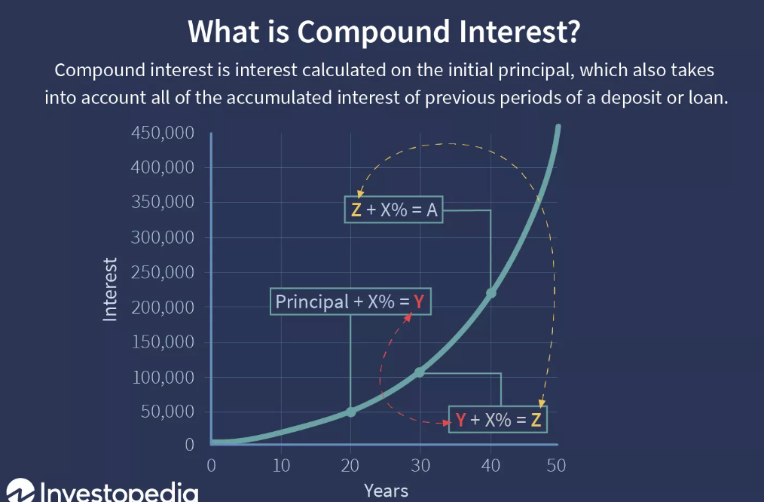
investments
Compound interest
  Interest on savings calculated on both the initial principal and the accumulated interest from previous periods.
  "Interest on interest," will make a sum grow faster than simple interest, which is calculated only on the principal amount
  Compounding multiplies money at an accelerated rate
  Can work both ways! You can make money by saving but you can also accumulate more debt!

Slide 8
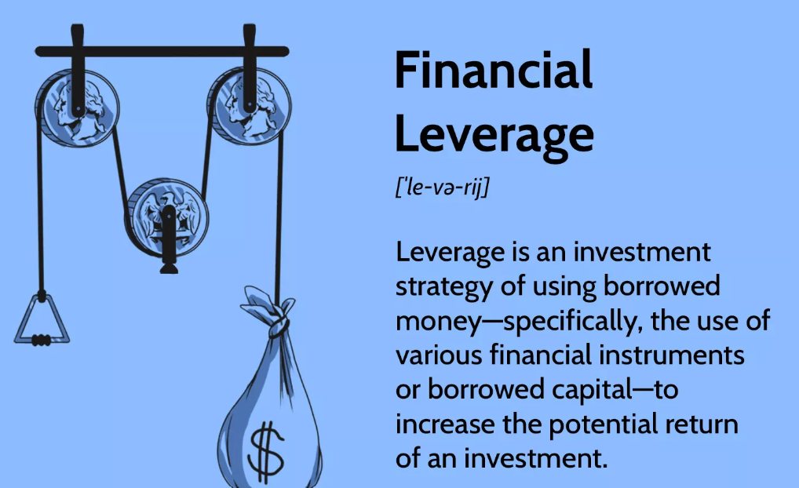
investments
Leverage
  Use borrowed money for investments in order to buy a large enough part of an investment so that you can control it
Leverage a very small investment into millions of dollars
Debt: borrowing money
  Typically at a compounded interest rate
  Set payback period

Slide 9
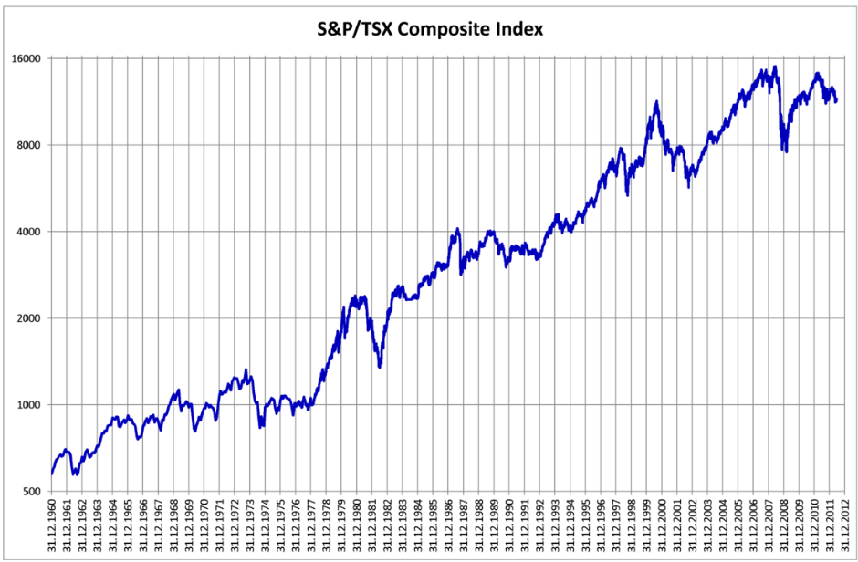
The Stock Market
Consists of exchanges in which stock shares and other financial securities of publicly held companies are bought and sold
  Average increase of 6-8%
Equities, options, Exchange Traded Funds (ETFs), bonds
Fees

Slide 10
The stock market
3% Rule
  Comfortably live off of 4% of your money in investments in your first year of retirement, then slightly increase or decrease that amount to account for inflation/performance each subsequent year
Law of Averages
  By contributing steadily over the years, you'll buy more shares of each investment option when prices are low, and fewer when prices are high. As a result, the average price per share of your investments may be lower than if you invested all your money at once
Dividend Reinvestment Plans (DRIPs)
  Allows investors to reinvest their cash dividends into additional shares or fractional shares of the underlying stock on the dividend payment date

Slide 11
SUMMARY
Each personal finance journey will be different, based on your goals, dreams, means and methods. The key is to tailor your journey to your life, interests and abilities. You need to make the most with what you’ve got!

Slide 12
THANK YOU
Lee Weiss Vassor, P.Eng, PMP, PhD​
roughpennypodcast@gmail.com
https://roughpenny.wordpress.com

